Slide 1
PCIe-NVMe Tools & Commands Introduction
Engineering 3 KC Lin
V1.0
2020/11/06

Slide 2
Agenda
Linux Commands
nvme-cli
sedutil
SMI Linux Tools

Slide 3
Linux commands

Slide 4
lsblk lspci dmesg
$ lsblk
NAME MAJ:MIN RM SIZE RO TYPE MOUNTPOINT
sda 8:0 0 111.8G 0 disk
`-sda1 8:1 0 111.8G 0 part /
nvme0n1 259:0 0 111.8G 0 disk
$ lspci
3c:00.0 Non-Volatile memory controller: Device 1db2:2302 (rev 03)
$ lspci -s 3c:00.0 –v
3c:00.0 Non-Volatile memory controller: Device 1db2:2302 (rev 03) (prog-if 02 [NVM Express])
Subsystem: Device 1db2:2302
Flags: bus master, fast devsel, latency 0, IRQ 16, NUMA node 0
Memory at dc000000 (64-bit, non-prefetchable) [size=16K]
Capabilities: [40] Power Management version 3
Capabilities: [50] MSI: Enable- Count=1/8 Maskable+ 64bit+
Capabilities: [70] Express Endpoint, MSI 00
Capabilities: [b0] MSI-X: Enable+ Count=16 Masked-
Capabilities: [100] Advanced Error Reporting
Capabilities: [158] Secondary PCI Express <?>
Capabilities: [178] Latency Tolerance Reporting
Capabilities: [180] L1 PM Substates
Kernel driver in use: nvme
$ dmesg
[ 0.464123] pci 0000:01:00.0: [1db2:2302] type 00 class 0x010802
[ 0.464139] pci 0000:01:00.0: reg 0x10: [mem 0xa1100000-0xa1103fff 64bit]
[ 0.464256] pci 0000:00:01.0: PCI bridge to [bus 01]
[ 1.053861] nvme nvme0: pci function 0000:01:00.0
[ 1.267951] nvme nvme0: missing or invalid SUBNQN field.
[ 1.275984] nvme nvme0: 4/0/0 default/read/poll queues

Slide 5
smartctl
$ smartctl –a /dev/nvme0
=== START OF INFORMATION SECTION ===
Model Number: ATP I-Temp. NVMe M.2 2280 SSD
Serial Number: 1111
Firmware Version: 42A0S79A
PCI Vendor/Subsystem ID: 0x1db2
IEEE OUI Identifier: 0x141357
Controller ID: 1
Number of Namespaces: 1
Namespace 1 Size/Capacity: 120,034,123,776 [120 GB]
Namespace 1 Utilization: 119,986,491,392 [119 GB]
Namespace 1 Formatted LBA Size: 512
Namespace 1 IEEE EUI-64: 141357 7010000001
Local Time is: Sat Oct 12 11:25:50 2019 UTC
Firmware Updates (0x14): 2 Slots, no Reset required
Optional Admin Commands (0x0017): Security Format Frmw_DL Self_Test
Optional NVM Commands (0x005f): Comp Wr_Unc DS_Mngmt Wr_Zero Sav/Sel_Feat Timestmp
Maximum Data Transfer Size: 64 Pages
Warning Comp. Temp. Threshold: 75 Celsius
Critical Comp. Temp. Threshold: 80 Celsius
Supported Power States
St Op Max Active Idle RL RT WL WT Ent_Lat Ex_Lat
0 + 9.00W - - 0 0 0 0 0 0
1 + 4.60W - - 1 1 1 1 0 0
2 + 3.80W - - 2 2 2 2 0 0
3 - 0.0450W - - 3 3 3 3 2000 2000
4 - 0.0040W - - 4 4 4 4 15000 15000
Supported LBA Sizes (NSID 0x1)
Id Fmt Data Metadt Rel_Perf
0 + 512 0 0
=== START OF SMART DATA SECTION ===
SMART overall-health self-assessment test result: PASSED
SMART/Health Information (NVMe Log 0x02)
Critical Warning: 0x00
Temperature: 35 Celsius
Available Spare: 100%
Available Spare Threshold: 10%
Percentage Used: 0%
Data Units Read: 46,160 [23.6 GB]
Data Units Written: 703,234 [360 GB]
Host Read Commands: 939,759
Host Write Commands: 1,373,504
Controller Busy Time: 50
Power Cycles: 17
Power On Hours: 77
Unsafe Shutdowns: 7
Media and Data Integrity Errors: 0
Error Information Log Entries: 0
Warning Comp. Temperature Time: 0
Critical Comp. Temperature Time: 0
Temperature Sensor 1: 25 Celsius
Temperature Sensor 2: 35 Celsius
Error Information (NVMe Log 0x01, max 256 entries)
No Errors Logged

Slide 6
nvme-cli

Slide 7
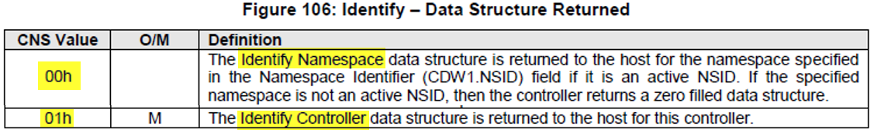
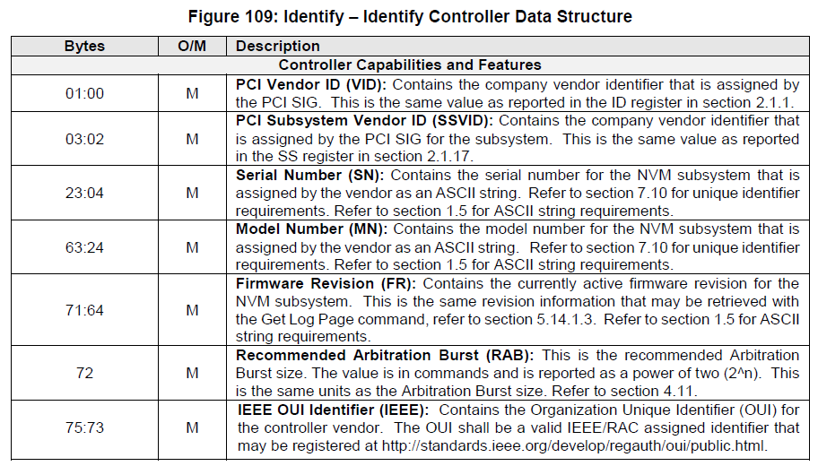
nvme-cli -id-ctl (Identify Controller)
# nvme id-ctrl -H /dev/nvme0
NVME Identify Controller:
vid : 0x1db2
ssvid : 0x1db2
sn : 1111
mn : ATP I-Temp. NVMe M.2 2280 SSD
fr : 42A0S79A
rab : 6
ieee : 141357
cmic : 0
[3:3] : 0 ANA not supported
[2:2] : 0 PCI
[1:1] : 0 Single Controller
[0:0] : 0 Single Port
mdts : 6
cntlid : 1
ver : 10300
rtd3r : 7a120
rtd3e : 1e8480
oaes : 0x200
[9:9] : 0x1 Firmware Activation Notices Supported
[8:8] : 0 Namespace Attribute Changed Event Not Supported
ctratt : 0
UART log

Slide 8
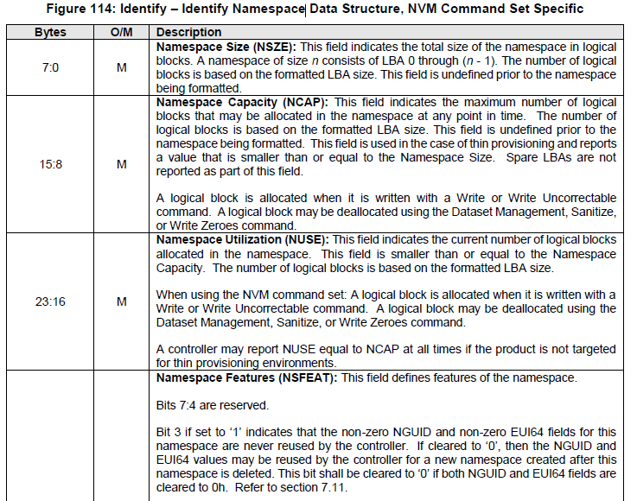
nvme-cli -id-ns (Identify Namespace)
# nvme -id-ns -H /dev/nvme0n1
NVME Identify Namespace 1:
nsze : 0xdf8fe2b0
ncap : 0xdf8fe2b0
nuse : 0
nsfeat : 0
[2:2] : 0 Deallocated or Unwritten Logical Block error Not Supported
[1:1] : 0 Namespace uses AWUN, AWUPF, and ACWU
[0:0] : 0 Thin Provisioning Not Supported
nlbaf : 0
flbas : 0
[4:4] : 0 Metadata Transferred in Separate Contiguous Buffer
[3:0] : 0 Current LBA Format Selected
mc : 0
[1:1] : 0 Metadata Pointer Not Supported
[0:0] : 0 Metadata as Part of Extended Data LBA Not Supported
dpc : 0
[4:4] : 0 Protection Information Transferred as Last 8 Bytes of Metadata Not Supported
[3:3] : 0 Protection Information Transferred as First 8 Bytes of
UART log

Slide 9
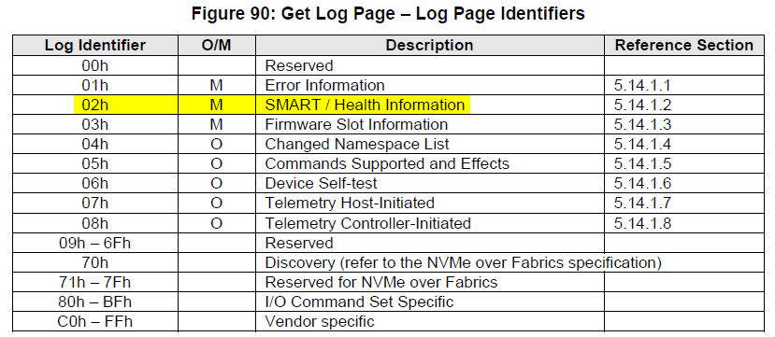
nvme-cli -smart
UART log
$ nvme -smart-log /dev/nvme0
Smart Log for NVME device:nvme0n1 namespace-id:ffffffff
critical_warning : 0
temperature : 35 C
available_spare : 100%
available_spare_threshold : 10%
percentage_used : 0%
data_units_read : 46160
data_units_written : 703234
host_read_commands : 939759
host_write_commands : 1373504
controller_busy_time : 50
power_cycles : 17
power_on_hours : 76
unsafe_shutdowns : 7
media_errors : 0
num_err_log_entries : 0
Warning Temperature Time : 0
Critical Composite Temperature Time : 0
Temperature Sensor 1 : 25 C
Temperature Sensor 2 : 35 C
Thermal Management T1 Trans Count : 0
Thermal Management T2 Trans Count : 0
Thermal Management T1 Total Time : 0
Thermal Management T2 Total Time : 0 $ nvme -get-log --log-id=0x02 --log-len=512 --raw-binary /dev/nvme0n1 | xxd
00000000: 0034 0164 0a00 0000 0000 0000 0000 0000 .4.d............
00000010: 0000 0000 0000 0000 0000 0000 0000 0000 ................
00000020: 8424 0000 0000 0000 0000 0000 0000 0000 .$..............
00000030: 2208 0000 0000 0000 0000 0000 0000 0000 "...............

Slide 10
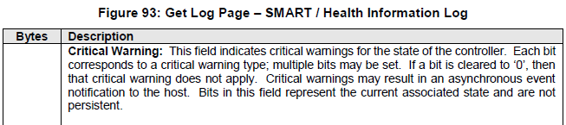
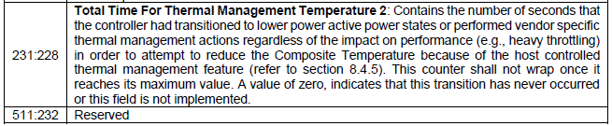
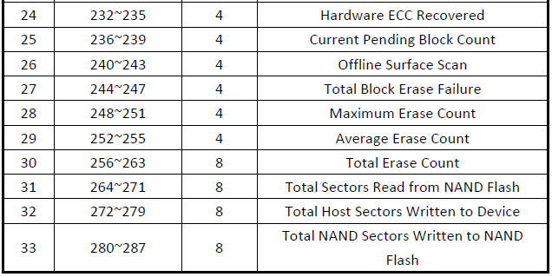
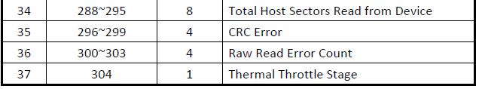
nvme-cli -smart – ATP specific
$ nvme smart-log --raw-binary /dev/nvme0n1 > smart.raw $ ./nvme-smart-atp.sh /dev/nvme0
0e8 Reallocated Flash Blocks Count = 0000
0ea Initial Spare Blocks = 0065
0ec Uncorrectable Sector Count = 00000000
0f0 Total Block Program Failure = 00000000
0f4 Reported Uncorrectable Errors = 00000000
0f8 Hardware ECC Recovered = 00000000
0fc Current Pending Block Count = 00000000
100 Offline Surface Scan = 00000000
104 Total Block Erase Failure = 00000000
108 Maximum Erase Count = 00000037
10c Average Erase Count = 00000037
110 Total Erase Count = 000000000000c314
118 Total NAND Read (sector) = 0000000000000000
120 Total Host Write (sector) = 0000000000000000
128 Total NAND Write (sector) = 0000000000000000
130 Total Host Read (sector) = 000000000000ab1f
138 CRC Error = 00000000
13c Raw Read Error Count = 00000000
140 Thermal Throttle Stage = 00
ATP specific SMART

Slide 11
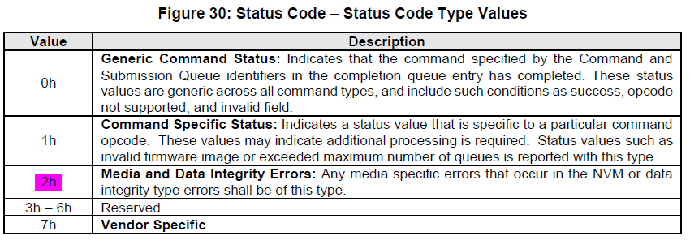
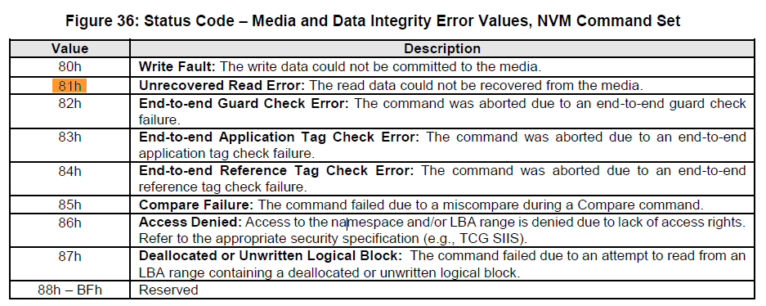

nvme-cli -error-log
$ nvme -error-log /dev/nvme0n1
Error Log Entries for device:nvme0n1 entries:64
.................
Entry[ 0]
.................
error_count : 3 <~~~ latest
sqid : 3
cmdid : 0x1be
status_field : 0x281(Unknown)
parm_err_loc : 0xffff
lba : 0x20
nsid : 0x1
vs : 0
cs : 0
.................
Entry[ 1]
.................
error_count : 2
sqid : 3
cmdid : 0x1bc
status_field : 0x281(Unknown)
parm_err_loc : 0xffff
lba : 0x8
nsid : 0x1
vs : 0
cs : 0
.................
Entry[ 2]
.................
error_count : 1 <~~~ oldest
sqid : 2
UART log:

Slide 12
nvme-cli -get-log – vendor specific
$ nvme -get-log --log-id=0xe0 --log-len=512 --raw-binary /dev/nvme0n1 | xxd
00000000: 00e0 0500 2020 2020 2020 2020 3139 3131 .... 1911
00000010: 3030 3035 2020 2020 2020 2020 5353 5337 0005 SSS7
00000020: 4132 3332 3837 2020 3230 3230 3136 3338 A23287 20201638
00000030: 5353 5353 3741 3238 3730 4131 4b31 3931 SSSS7A2870A1K191
00000040: 3130 3030 352d 3030 3030 3135 2020 2020 10005-000015
00000050: 2020 2020 2020 2020 2020 2020 2020 2020
00000060: 2020 2020 2020 2020 2020 2031 3931 3130 19110
00000070: 3030 352d 3030 3030 3135 2020 2020 204c 005-000015 L
00000080: 656e 6f76 6f28 4154 5029 2020 2020 2020 enovo(ATP)
00000090: 2020 2020 2020 2030 3259 4731 3338 2020 02YG138
000000a0: 2020 2053 4d44 3741 3737 3930 3220 2054 SMD7A77902 T
000000b0: 6869 6e6b 5379 7374 656d 204d 2e32 204e hinkSystem M.2 N
000000c0: 3630 3053 6920 312e 3932 5442 204e 564d 600Si 1.92TB NVM
000000d0: 6520 5043 4965 2033 2e30 2078 3420 4e6f e PCIe 3.0 x4 No
000000e0: 6e2d 486f 7420 5377 6170 2053 5344 2028 n-Hot Swap SSD (
000000f0: 496e 6475 7374 7269 616c 2920 2020 2020 Industrial)
00000100: 2020 2020 2020 2020 2020 2020 2020 2000 .
00000110: 5353 5337 4132 3332 3837 2020 4154 5041 SSS7A23287 ATPA
00000120: 4631 5439 3253 544a 412d 4c56 3220 3032 F1T92STJA-LV2 02
00000130: 5947 3133 3844 3741 3737 3930 3220 2020 YG138D7A77902
00000140: 2020 2009 0000 0000 0000 0000 0000 0000 .............
00000150: 0000 0000 0000 0000 0000 0000 0000 0000 ................ Event log: Admin (0000591051 ms), Admin_GET_LOG_PAGE, NSID=0xFFFFFFFF
Host (0000591051 ms), NVMeGetLogPage , LID=0x00E0, NumDW=0x0000007F, RAE = 0x00, LSP = 0x00
Host (0000591051 ms), NVMeGetLogPage , OffsetLower = 0x00000000, OffsetUpper = 0x00000000

Slide 13
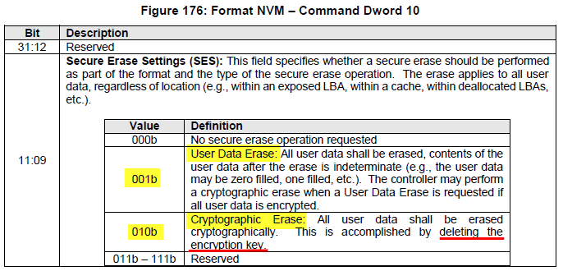
nvme-cli -format
# nvme -id-ctrl -H /dev/nvme0
oacs : 0x17
…
[1:1] : 0x1 Format NVM Supported
# nvme -format --ses=1 /dev/nvme0
Success formatting namespace:ffffffff Event log: # nvme -format --ses=2 /dev/nvme0 # For SED drive Success formatting namespace:ffffffff Event log:

Slide 14



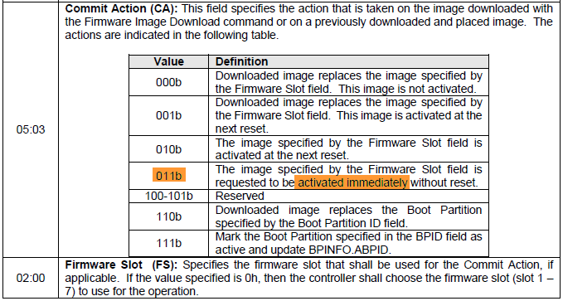
nvme-cli -fw-download/-fw-commit (1)
<1> Original firmware # nvme -id-ctrl -H /dev/nvme0 | grep “fr ” fr : 42AAT7GC <2> Firmware download to SSD
# nvme -fw-download /dev/nvme0 --fw=7GD.bin
Firmware download success
<3> Commit firmware - Activated immediately
# nvme fw-commit /dev/nvme0 --slot=1 --action=0 Success committing firmware action:0 slot:1 # nvme fw-commit /dev/nvme0 --slot=1 --action=3 Success committing firmware action:3 slot:1 <4> New firmware activated # nvme -id-ctrl -H /dev/nvme0 | grep “fr ” fr : 42AAT7GD <*> Check firmware versions on slots # nvme fw-log /dev/nvme0
Firmware Log for device:nvme0
afi : 0x22
frs1 : 0x4447375441413234 (42AAT7GD)
frs2 : 0x4347375441413234 (42AAT7GC)
UART log

Slide 15


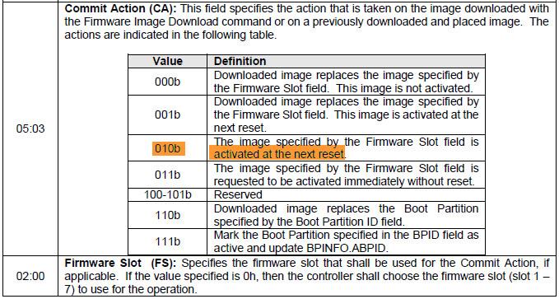
nvme-cli -fw-download/-fw-commit (2)
<1> Original firmware # nvme -id-ctrl -H /dev/nvme0 | grep “fr ” fr : 42AAT7GD <2> Firmware download to SSD
# nvme -fw-download /dev/nvme0 --fw=7GC.bin
Firmware download success
<3> Commit firmware - Activated after reset # nvme fw-commit /dev/nvme0 --slot=2 --action=0 Success committing firmware action:0 slot:2 # nvme fw-commit /dev/nvme0 --slot=2 --action=2 Success committing firmware action:2 slot:2 <4> firmware NOT activated yet # nvme -id-ctrl -H /dev/nvme0 | grep “fr ” fr : 42AAT7GD <5> reset # nvme reset /dev/nvme0
<6> New firmware activated # nvme -id-ctrl -H /dev/nvme0 | grep “fr ” fr : 42AAT7GC
UART log

Slide 16
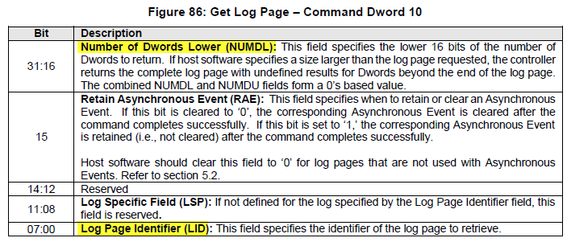
nvme-cli -admin-passthru (arbitrary admin command)
Example: SMART $ nvme admin-passthru /dev/nvme0 --data-len=512 --opcode=0x02 --cdw10=0x7F0002 -r
NVMe command result:00000000 128DW SMART
0 1 2 3 4 5 6 7 8 9 a b c d e f
0000: 00 35 01 64 0a 00 00 00 00 00 00 00 00 00 00 00 ".5.d............"
0010: 00 00 00 00 00 00 00 00 00 00 00 00 00 00 00 00 "................"
0020: 2d 00 00 00 00 00 00 00 00 00 00 00 00 00 00 00 "-..............."
0030: 00 00 00 00 00 00 00 00 00 00 00 00 00 00 00 00 "................"
0040: e5 03 00 00 00 00 00 00 00 00 00 00 00 00 00 00 "................"
0050: 00 00 00 00 00 00 00 00 00 00 00 00 00 00 00 00 "................"
0060: 00 00 00 00 00 00 00 00 00 00 00 00 00 00 00 00 "................"
0070: 07 00 00 00 00 00 00 00 00 00 00 00 00 00 00 00 "................"
0080: 7c 00 00 00 00 00 00 00 00 00 00 00 00 00 00 00 "|..............."
0090: 03 00 00 00 00 00 00 00 00 00 00 00 00 00 00 00 "................"
00a0: 00 00 00 00 00 00 00 00 00 00 00 00 00 00 00 00 "................"
…
Example: Vendor command $ nvme admin-passthru /dev/nvme0 --opcode=0xcd -l 512 --cdw12=<Password> -i cdc.bin --write
cdc.bin
00000000: 05 cd 00 11 22 6f 00 00 00 00 31 30 32 59 47 38 ...."o....102YG8
00000010: 38 38 20 20 20 20 20 53 4d 44 37 41 37 37 38 38 88 SMD7A7788
00000020: 38 20 20 54 68 69 6e 6b 53 79 73 74 65 6d 20 4d 8 ThinkSystem M
00000030: 2e 32 20 4e 36 30 30 53 69 20 38 38 38 47 42 20 .2 N600Si 888GB
00000040: 4e 56 4d 65 20 50 43 49 65 20 33 2e 30 20 78 34 NVMe PCIe 3.0 x4
00000050: 20 4e 6f 6e 2d 48 6f 74 20 53 77 61 70 20 53 53 Non-Hot Swap SS
00000060: 44 20 28 49 6e 64 75 73 74 72 69 61 6c 29 20 20 D (Industrial)
00000070: 20 20 20 20 20 20 20 20 20 20 20 20 20 20 20 20
00000080: 20 20 20 41 54 50 41 46 38 38 38 47 53 54 4a 41 ATPAF888GSTJA
00000090: 2d 4c 56 32 20 20 20 20 20 20 20 20 20 20 20 20 -LV2
…
UART log

Slide 17


nvme-cli -read/-writ
$ nvme -read /dev/nvme0n1 -v -t --start-block=0x100 --block-count=7 --data-size=4096 -data=test.bin opcode : 02 <note> if data-size > block-count, the reset will be filled with 0
flags : 00
control : 0000
nblocks : 0007
rsvd : 0000
metadata : 0
addr : 55f31cb4c000
slba : 100
dsmgmt : 00000000
reftag : 00000000
apptag : 0000
appmask : 0000
latency: read: 346 us
read: Success
$ nvme -write /dev/nvme0n1 -v -t --start-block=0x100 --block-count=7 --data-size=4096 -data=test.bin opcode : 01 <note> if data-size > block-count, the reset will be transfer with 0
flags : 00
control : 0000
nblocks : 0007
rsvd : 0000
metadata : 0
addr : 561c2784d000
slba : 100
dsmgmt : 00000000
reftag : 00000000
apptag : 0000
appmask : 0000
latency: write: 309 us
write: Success
UART log
UART log

Slide 18

nvme-cli -write-uncor ( mark logical blocks as invalid)
Mark invalid by -write-uncor
$ nvme -write-uncor /dev/nvme0n1 --start-block=0 --block-count=0 NVME Write Uncorrectable Success
Device reports “read error” on read command $ nvme -read /dev/nvme0n1 --start-block=0 --block-count=0 --data-size=512 -data=test.bin read:READ_ERROR: The read data could not be recovered from the media(2281)
Clear uncorrectable sectors by format command $ nvme -format --ses=1 /dev/nvme0n1 Success formatting namespace:1
Read okay after format
$ nvme -read /dev/nvme0n1 --start-block=0 --block-count=0 --data-size=512 -data=test.bin read: Success Note: <1> The device will still return the data on the invalid LBA. <2> After format, all data will be cleared as zero.
UART log
UART log

Slide 19
nvme-cli -reset (1)
$ nvme -reset /dev/nvme0 # Reset the nvme controller UART log: Admin (0002725338 ms), Admin_Delete_IOSQ
Admin (0002725338 ms), QID=0004
Admin (0002725338 ms), Admin_Delete_IOSQ
Admin (0002725338 ms), QID=0003
Admin (0002725338 ms), Admin_Delete_IOSQ
Admin (0002725338 ms), QID=0002
Admin (0002725338 ms), Admin_Delete_IOSQ Admin (0002725338 ms), QID=0001 …. Admin (0002725339 ms), Admin_Delete_IOCQ
Admin (0002725339 ms), QID=0004
Admin (0002725339 ms), Admin_Delete_IOCQ
Admin (0002725339 ms), QID=0003
Admin (0002725339 ms), Admin_Delete_IOCQ
Admin (0002725339 ms), QID=0002
Admin (0002725339 ms), Admin_Delete_IOCQ
Admin (0002725339 ms), QID=0001 …. Host (0002725340 ms), NVMe Reset(ISR), Link state =0x0011, CC_EN = 0x00, CC_RDY = 0x01, Cmd_RDY = 0x0000
Host (0002725340 ms), NVMe Int_LOW_Sts = 0x00002C00, NVMe Int_HIGH_Sts = 0x00000043
Host (0002725340 ms), buffer=0x0000
Host (0002725340 ms), NVMe reset done, Link State=0x0011

Slide 20
nvme-cli -reset (2)
--- conti --- UART log: Host (0002725472 ms), NVMe EN (cc_en on)(ISR), Link State=0x0011
Host (0002725472 ms), buffer=0x0000 Host (0002725473 ms), NVMe EN (set cc_rdy), Link State=0x0011
…..
Admin 0002.725.578, Admin_IDENTIFY, CNS Value=0x0001, NSID=0x0000
Admin 0002.725.578, Admin_GET_LOG_PAGE, NSID=0xFFFFFFFF
Host 0002.725.578, NVMeGetLogPage , LID=0x0005, NumDW=0x000003FF, RAE = 0x00, LSP = 0x00
Host 0002.725.579, NVMeGetLogPage , OffsetLower = 0x00000000, OffsetUpper = 0x00000000
Admin 0002.725.579, Admin_SET_FEATURES
Host 0002.725.579, Set FID = 0x000C, SV = 0x0000, Attr. = 0x00000001 ……. Admin 0002.725.584, Admin_Create_IOCQ
Admin 0002.725.584, QID=0001
Admin 0002.725.584, QSIZE=0x03FF, QIV=0001, QIEN=0001, PC=0001
Admin 0002.725.584, BA_H=0x00000002, BA_L=0x5D254000
Admin 0002.725.585, Create CQ, QID = 0x0001, MSI-X Interrupt Vector = 0x0001
Admin 0002.725.585, Admin_Create_IOSQ
Admin 0002.725.585, QID=0001
Admin 0002.725.585, QSIZE=0x03FF, CQID=0001, QPRIO=0000, PC=0001
Admin 0002.725.585, BA_H=0x00000002, BA_L=0x5D260000
…….
Admin 0002.725.589, Admin_Create_IOSQ
Admin 0002.725.589, QID=0004
Admin 0002.725.589, QSIZE=0x03FF, CQID=0004, QPRIO=0000, PC=0001
Admin 0002.725.590, BA_H=0x00000002, BA_L=0x5D2A0000
……

Slide 21
sedutil

Slide 22
sedutil
Scan OPAL compliant disks # sedutil-cli --scan
Scanning for Opal compliant disks
/dev/nvme0 2 ATP I-Temp. NVMe M.2 2280 SSD 42A0S79B
Check Security Status # sedutil-cli --query /dev/nvme0
One or more header fields have 0 length
Properties exchange failed
/dev/nvme0n1 NVMe INTEL SSDPEKKF256G8L L08P BTHH827610QT256B
TPer function (0x0001)
ACKNAK = N, ASYNC = N. BufferManagement = N, comIDManagement = N, Streaming = Y, SYNC = Y
Locking function (0x0002)
Locked = N, LockingEnabled = N, LockingSupported = Y, MBRDone = N, MBREnabled = N, MediaEncrypt = Y Initialization # sedutil-cli --initialsetup mypassword /dev/nvme0n1
takeOwnership complete
Locking SP Activate Complete
LockingRange0 disabled
LockingRange0 set to RW
MBRDone set on
MBRDone set on
MBREnable set on
Initial setup of TPer complete on /dev/nvme0n1

Slide 23
sedutil
Lock set/enable # sedutil-cli --setLockingRange 0 rw mypassword /dev/nvme0n1 LockingRange0 set to RW # sedutil-cli --enableLockingRange 0 mypassword /dev/nvme0n1 LockingRange0 enabled ReadLocking,WriteLocking Drive will be locked after power cycling # sedutil-cli --query /dev/nvme0
/dev/nvme0 NVMe ATP I-Temp. NVMe M.2 2280 SSD 42A2S8DB 00123456789876543210
TPer function (0x0001)
ACKNAK = N, ASYNC = N. BufferManagement = N, comIDManagement = N, Streaming = Y, SYNC = Y
Locking function (0x0002)
Locked = Y, LockingEnabled = Y, LockingSupported = Y, MBRDone = N, MBREnabled = Y, MediaEncrypt = Y
Unlock
# sedutil-cli --disableLockingRange 0 mypassword /dev/nvme0n1
LockingRange0 disabled # sedutil-cli --query /dev/nvme0
/dev/nvme0 NVMe ATP I-Temp. NVMe M.2 2280 SSD 42A2S8DB 00123456789876543210
TPer function (0x0001)
ACKNAK = N, ASYNC = N. BufferManagement = N, comIDManagement = N, Streaming = Y, SYNC = Y
Locking function (0x0002)
Locked = N, LockingEnabled = Y, LockingSupported = Y, MBRDone = N, MBREnabled = Y, MediaEncrypt = Y
PSID Revert # sedutil-cli --yesIreallywanttoERASEALLmydatausingthePSID PSIDPSIDPSIDPSIDPSIDPSIDPSIDPSID /dev/nvme0n1
revertTper completed successfully

Slide 24
sedutil - PBA
Pre-boot authentication (PBA) or power-on authentication (POA) serves as an extension of the BIOS, UEFI or boot firmware and guarantees a secure, tamper-proof environment external to the operating system as a trusted authentication layer. The PBA prevents anything being read from the hard disk such as the operating system until the user has confirmed they have the correct password or other credentials including multi-factor authentication. Set Lock & MBRDone # sedutil-cli --enablelockingrange 0 mypassword /dev/nvme0
LockingRange0 enabled ReadLocking,WriteLocking
# sedutil-cli --setlockingrange 0 lk mypassword /dev/nvme0
LockingRange0 set to LK
# sedutil-cli --setmbrdone off mypassword /dev/nvme0
MBRDone set off Write PBA to MBR sedutil-cli --loadpbaimage mypassword UEFI64.img /dev/nvme0
Writing PBA to /dev/nvme0
33554432 of 33554432 100% blk=20382
PBA image UEFI64.img written to /dev/nvme0 After power cycling, the screen will request the password; Enter the password to unlock the drove: DTA LINUX Pre Boot Authorization
Please enter pass-phrase to unlock OPAL drives: ***** <~~~~~~ enter pass-phrase
Scanning....
Drive /dev/nvme0 ATP I-Temp. NVMe M.2 2280 SSD is OPAL Unlocked

Slide 25
SMI Linux Tools

Slide 26
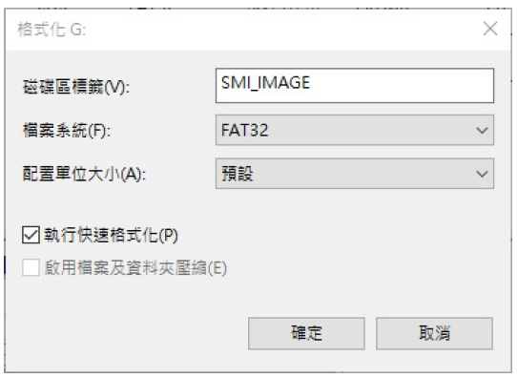
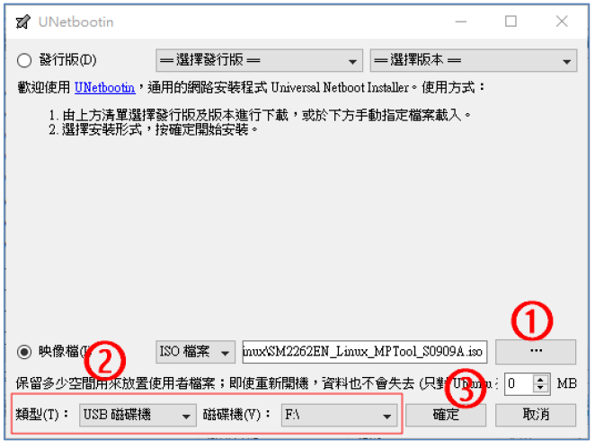
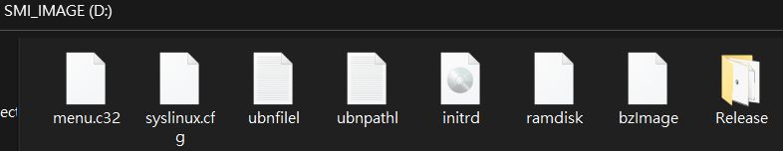
SMI Linux FW update (1) Build USB Live CD
[Step 1] Format the USB Disk with FAT32 format and label “SMI_IMAGE”
[Step 2] Run “UNetbootin” to create image: (1) Select SMI Image file (SM2262EN_Linux_MPToo.iso)
(2) Select USB device
(3) Click start button
(4) Files below will be created in the USB Disk:

Slide 27
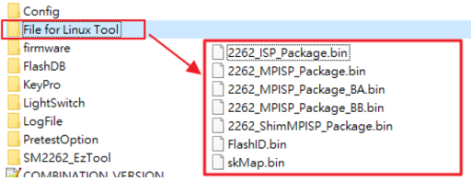
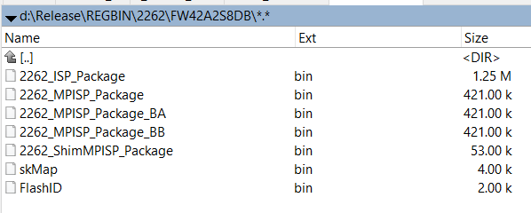
SMI Linux FW update (2) Create Linux Package
[Step 1] Use Windows MPTool to generate the firmware bin files.
The bin files will be created in the folder “MPTool\File for Linux Tool”
[Note] Each BOM needs to create its own bin files due to the specific settings/parameters.
[Step 2] Copy these files to the USB Disk ../Release/REGBIN/2262/XXXX/

Slide 28
SMI Linux FW update (3) Boot from USB Live CD
Boot from the USB Disk and Linux will download firmware bin file to NVMe drive automatically.
The screen will show the firmware refresh process; You could also check the log file “Display.log” on the USB Disk after firmware update finished: Copyright (C) 2017 SiliconMotion Company Design by DT2-SW
…
********** Initial ISP flow ***********
Input SN:66666666666666666666
Card Information......................
Serial Number: 66666666666666666666
Model Name : ATP I-Temp. NVMe M.2 2280 SSD
Firmware Ver : 42A2S8DB <~~~ old firmware
Success
Open File .............................
*** ./REGBIN/2262/FW42A2S96B/Update_ISP_Package.bin ***
Success
... ----------- Card Information ------------
Serial Number: 66666666666666666666
Model Name : ATP I-Temp. NVMe M.2 2280 SSD
Firmware Ver : 42A2S96B <~~~ new firmware
-----------------------------------------
…
*****************************************
Total Process finished,the result is Pass
*****************************************

Slide 29
SMI Linux Event Log Dump (1)
[Step1] Copy the folder to Linux directory:
$ tree
.
|-- NVMe_SM2262_Tool_32_RSA
|-- NVMe_SM2262_Tool_64_RSA
|-- REGBIN
| `-- 2262
| |-- 2262_ISP_Package.bin
| |-- 2262_MPISP_Package.bin
| |-- 2262_MPISP_Package_BA.bin
| |-- 2262_MPISP_Package_BB.bin
| |-- 2262_ShimMPISP_Package.bin
| |-- FlashID.bin
| `-- skMap.bin
`-- lib
|-- 32
| `-- libcrypto.so.1.0.0
|-- 64
| |-- libcrypto.so.1.0.0
| `-- libcrypto.so.10
`-- ARCH64
`-- libcrypto.so.1.0.0
from folder “MPTool\File for Linux Tool”

Slide 30
SMI Linux Event Log Dump (2)
[Step2] Go to the folder and run the tool:
$ ./NVMe_SM2262_Tool_64_RSA -list dump_log 1 …
Found SMI NVMe Device 0
NVMe Device : /dev/nvme0n1
Serial Number : 66666666666666666666
Model Name : ATP I-Temp. NVMe M.2 2280 SSD
Firmware Version : 42A2S96B
…
Please select NVMe device: 0
*****************************************
******** Dump Event Log flow **********
*****************************************
Create Folder! <LogInfo_1029_0000>
Total Log Count: 8
Sector Count Per Page: 128
Dump Event Log........................ Success
Linux Tool T0923A, Lib:227
*****************************************
Total Process finished,the result is Pass
*****************************************

Slide 31
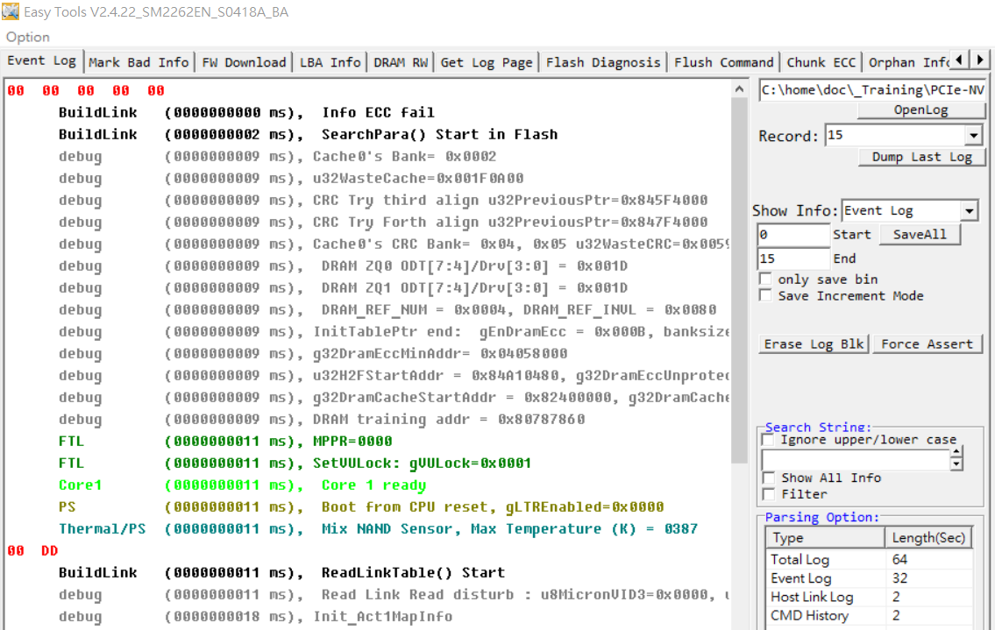
SMI Linux Event Log Dump (3)
[Step3] Use EZTool to parse the event logs under Windows $ tree LogInfo_1029_0000
LogInfo_1029_0000
|-- 00000_LogFile.bin
|-- 00001_LogFile.bin
|-- 00002_LogFile.bin
|-- 00003_LogFile.bin
|-- 00004_LogFile.bin
|-- 00005_LogFile.bin
|-- 00006_LogFile.bin
|-- 00007_LogFile.bin
`-- TotalLogFile.bin

